Slide 1
Politics in Sports: 1924 Paris Olympic Games
Alar Lipping, Ph.D.
Chair and Professor, Department of Kinesiology and Health
Northern Kentucky University
www.nku.edu/~Lipping

Slide 2
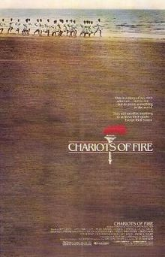
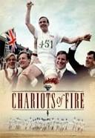
Chariots of Fire

Slide 3
Flying Scotsman Eric Liddell (400 meters)

Slide 4
Harold Abrahams 100 Meters

Slide 5
Jackson Scholtz 200 Meters

Slide 6
Douglas Lowe 800 meters

Slide 7
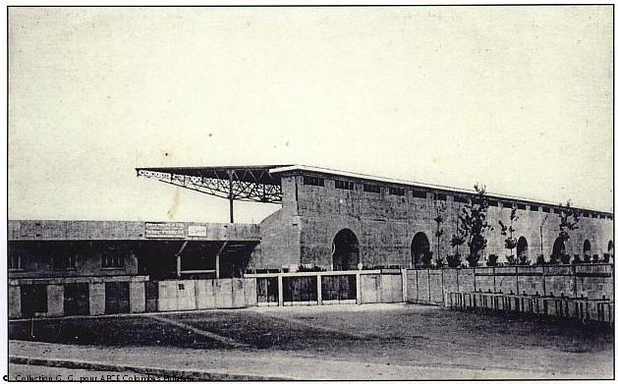
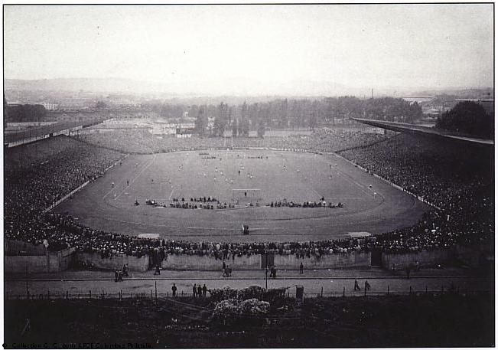
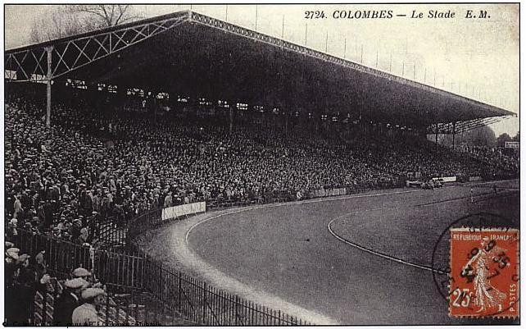
Colombes Olympic Stadium

Slide 8
Flying Finns Lentävä suomalainen
Paavo Nurmi 5 Gold Medals
Ville Ritola 4 Gold Medals, 2 Silver
Elias Katz 1 Gold, 1 Silver
Albin Stenroos 1Gold
Heikki Liimatainen 1 Gold

Slide 9
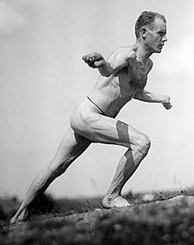
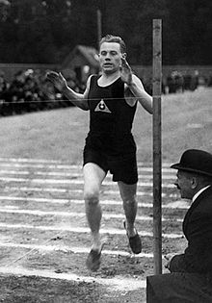
Paavo Nurmi

Slide 10
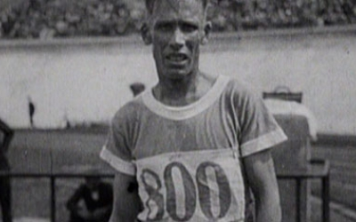
Ville Ritola Ottaa ritolat

Slide 11
Eero Lehtonen Pentathlon

Slide 12
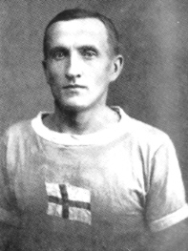
Katz (running second to Nurmi) and Liimatainen

Slide 13
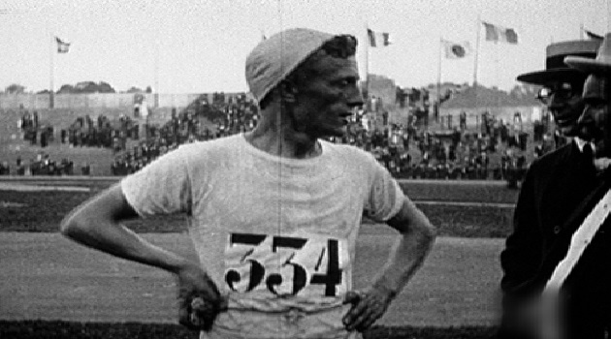
Albin Stenroos

Slide 14
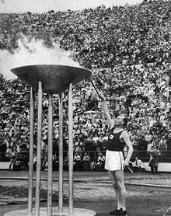
Nurmi Lighting the Olympic Flame in 1952 Helsinki Games

Slide 15
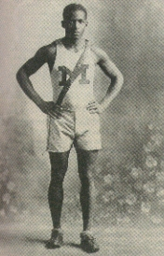
DeHart Hubbard Long Jump
First African American to win an individual Olympic Gold Medal

Slide 16
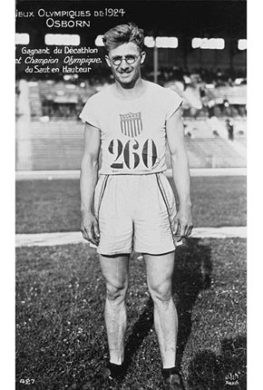
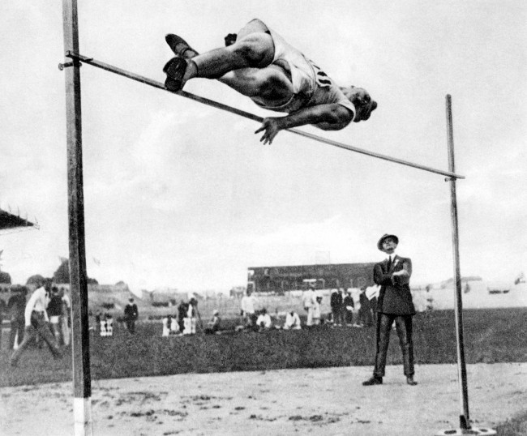
Harold Osborn
Gold Medals in High Jump and Decathlon

Slide 17
Roger Ducret 3 Gold, 2 Silver

Slide 18
Ellen Osiier (Den) First Women’s Fencing Gold Medalist

Slide 19
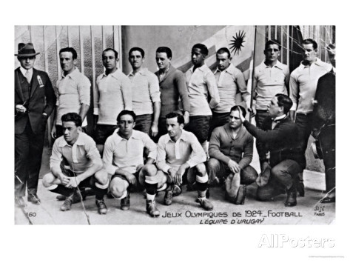
Football
Uruguay Gold Medal

Slide 20
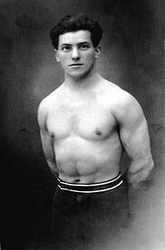
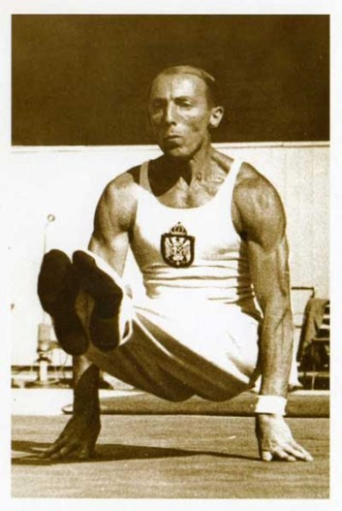
Gymnastics
Bedrich Supcik (CZE) Rope Climbing
Leon Stukelj (YUG) All Around

Slide 21
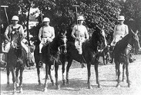
Polo
Argentina Gold Medal

Slide 22
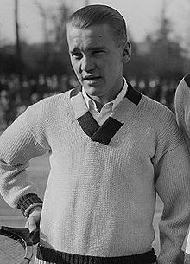
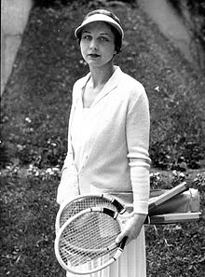
Tennis
Five Gold Medals USA
Vincent Richards Men’s Singles Gold Medal
Helen Wills Moody Women’s Singles Gold

Slide 23
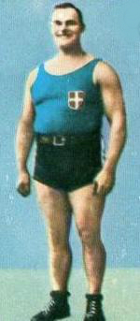
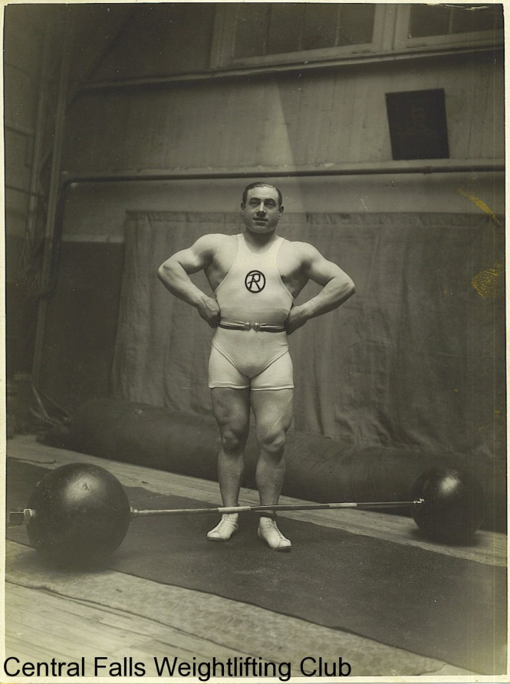
Weightlifting
Guiseppe Tonani Heavy Weight Gold
Charles Rigoulet Light Heavy Weight Gold

Slide 24
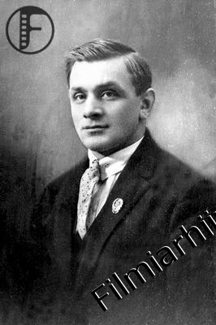
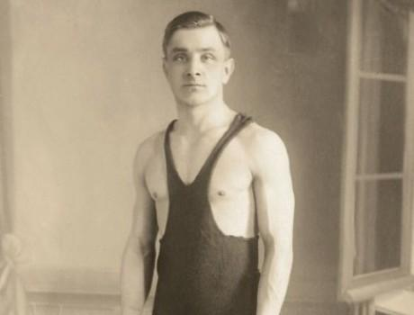
Wrestling Greco-Roman
Eduard Pütsep Bantam Weight Gold Medal

Slide 25
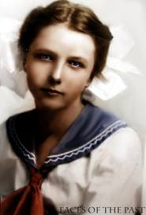
Women’s Diving
Two Events: Americans win five of six medals
Elizabeth Becker and Caroline Smith

Slide 26
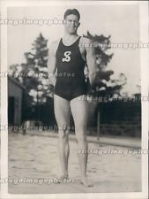
Men’s Diving
Three Events: Albert White of USA wins gold medals in three and ten meter springboard

Slide 27
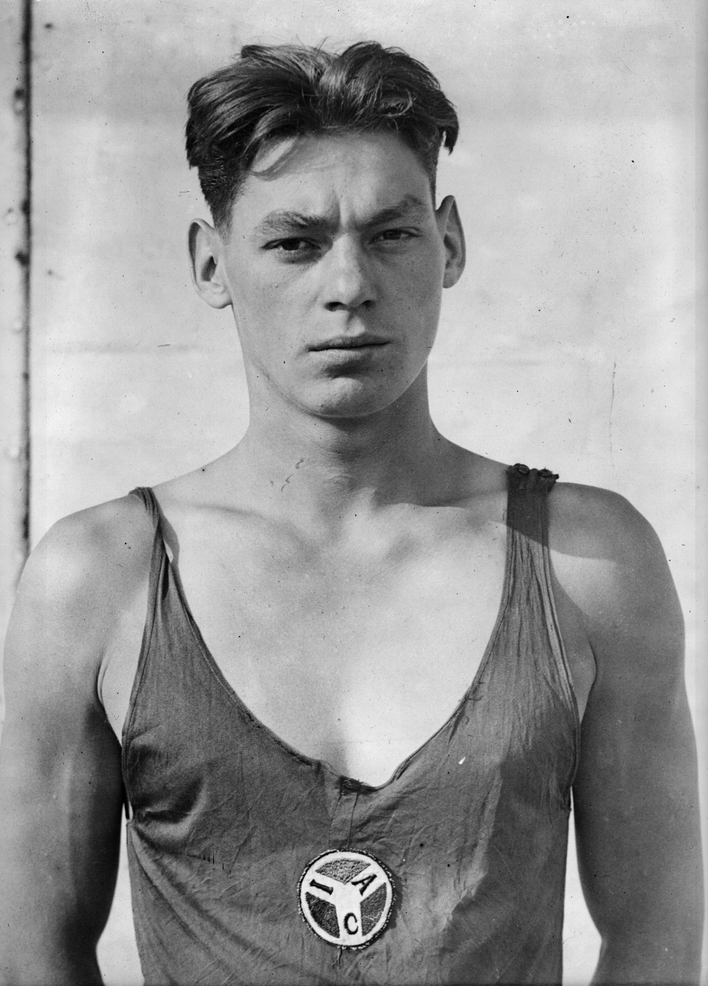
Johnny Weissmuller Three Gold Medals

Slide 28
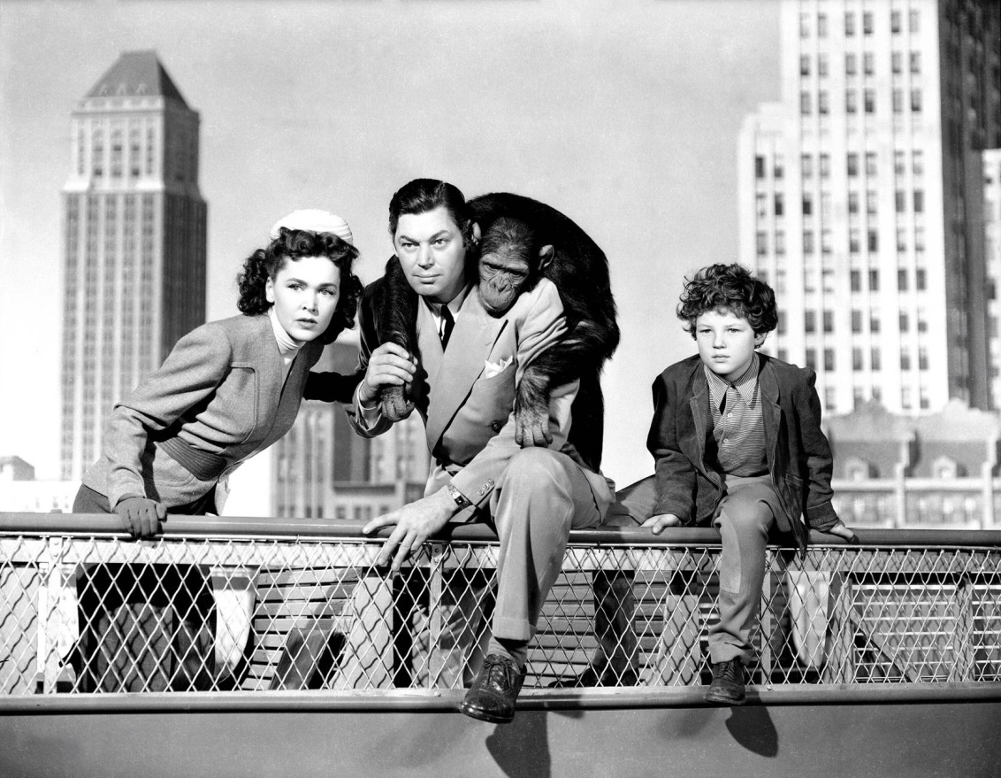
Tarzan

Slide 29
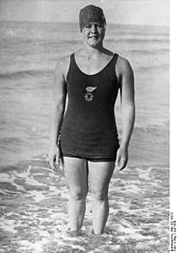
Women’s Swimming Gertrude Ederle
Gertrude Ederle 1 Gold Medal, 2 Bronze
1926 becomes first woman to swim English Channel

Slide 30
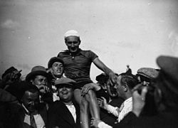
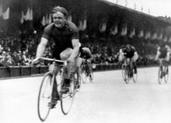
Cycling
Ko Willems 50 KM
Armand Blanchonet

Slide 31
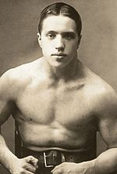
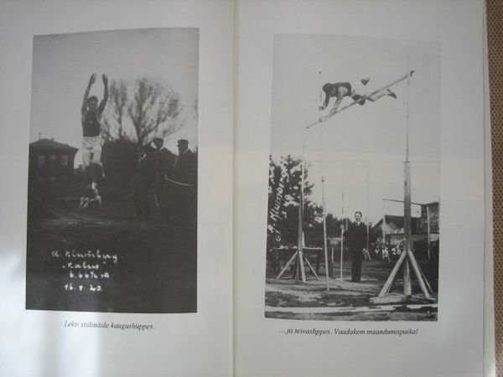
Estonian Athletes
44 male athletes, 6 medals, 1 gold, 1 silver, 4 bronze
Eduard Pütsep (Greco Roman, gold), Alfred Neuland (weightlifitng, silver), Aleksander Klumberg (decathlon, bronze), Jaan Kikkas (weightlifting, bronze), Harald Tammer (weightlifting, bronze), Roman Steinberg (Greco Roman, bronze)

