Slide 1
Politics in Sports: 1924 Paris Olympic Games
Alar Lipping, Ph.D.
Chair and Professor, Department of Kinesiology and Health
Northern Kentucky University
www.nku.edu/~Lipping

Slide 2
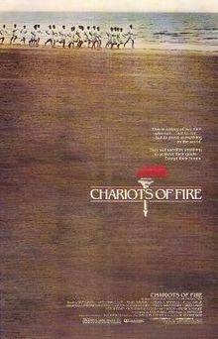
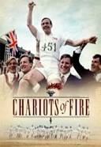
Chariots of Fire

Slide 3
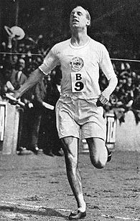
Flying Scotsman
Eric Liddell (400 meters)

Slide 4
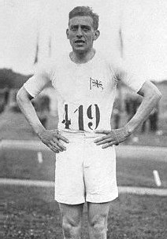
Harold Abrahams
100 Meters

Slide 5
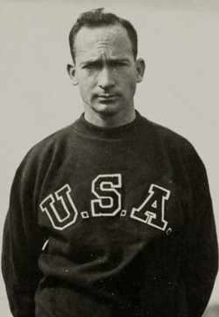
Jackson Scholtz
200 Meters

Slide 6
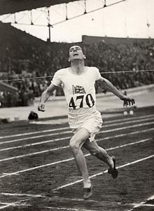
Douglas Lowe
800 meters

Slide 7
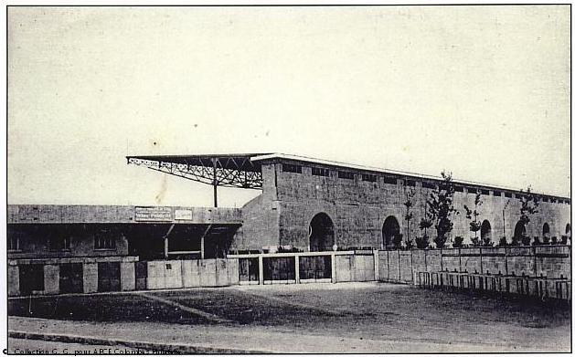
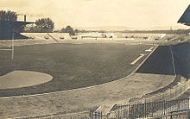
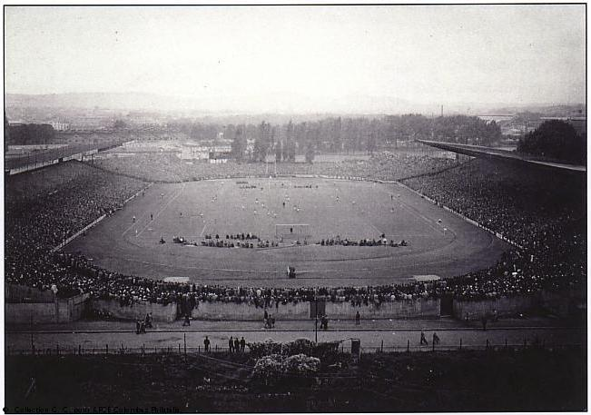
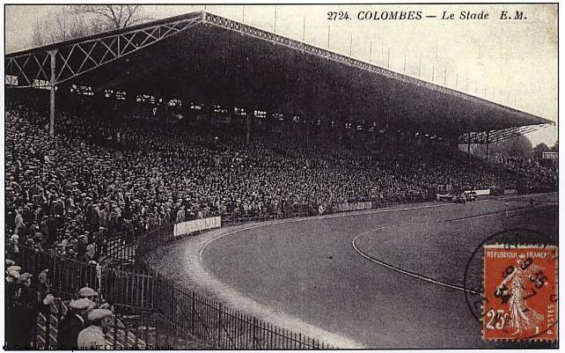
Colombes Olympic Stadium

Slide 8
Flying Finns
Lentävä suomalainen
Paavo Nurmi 5 Gold Medals
Ville Ritola 4 Gold Medals, 2 Silver
Elias Katz 1 Gold, 1 Silver
Albin Stenroos 1Gold
Heikki Liimatainen 1 Gold

Slide 9
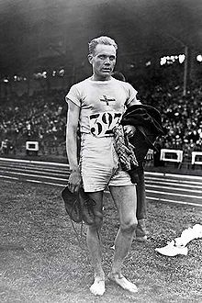
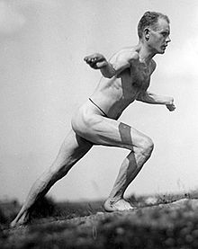
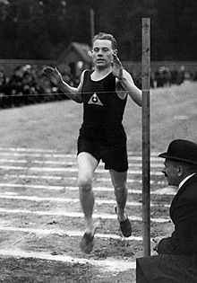
Paavo Nurmi

Slide 10
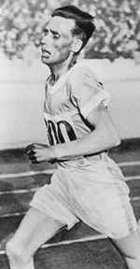
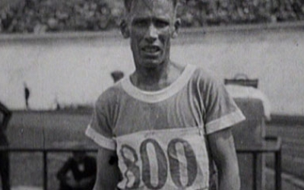
Ville Ritola
Ottaa ritolat

Slide 11
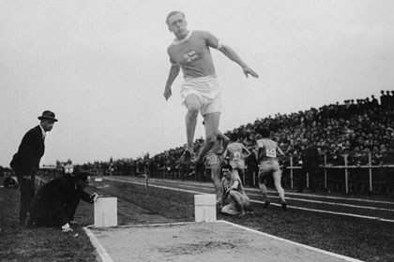
Eero Lehtonen
Pentathlon

Slide 12
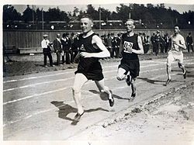
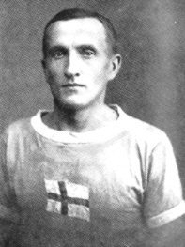
Katz (running second to Nurmi) and Liimatainen

Slide 13
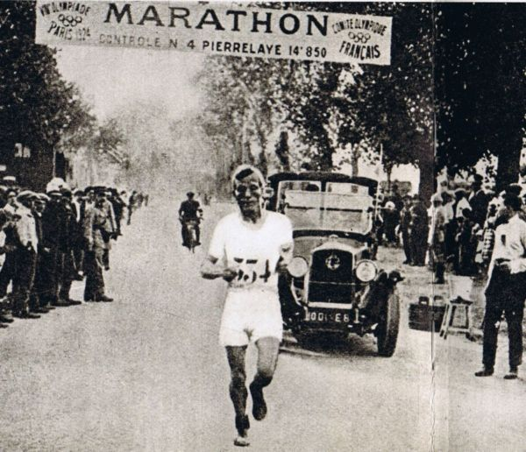
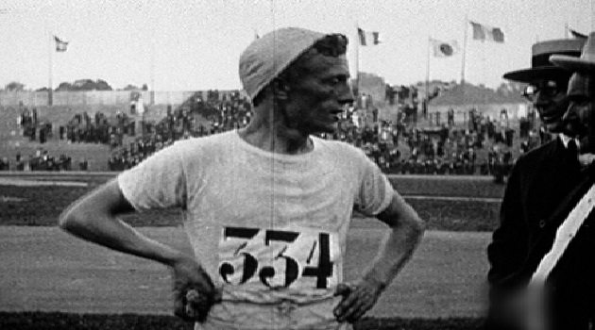
Albin Stenroos

Slide 14
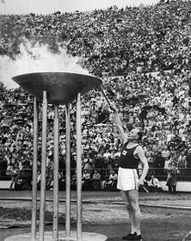
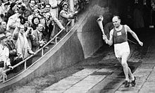
Nurmi Lighting the Olympic Flame in 1952 Helsinki Games

Slide 15
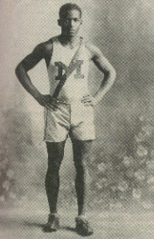
DeHart Hubbard
Long Jump
First African American to win an individual Olympic Gold Medal

Slide 16
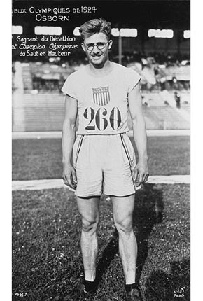
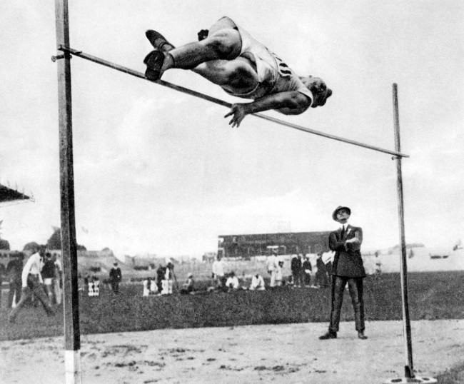
Harold Osborn
Gold Medals in High Jump and Decathlon

Slide 17
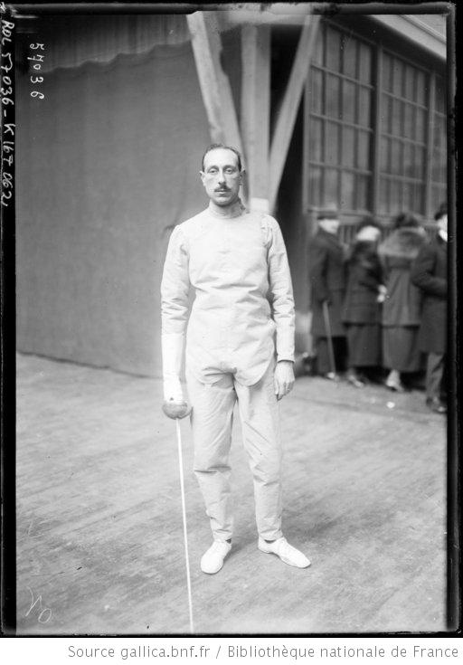
Roger Ducret
3 Gold, 2 Silver

Slide 18

Ellen Osiier (Den) First Women’s Fencing Gold Medalist

Slide 19
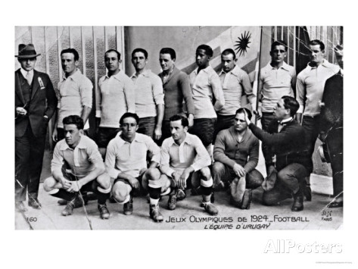
Football
Uruguay Gold Medal

Slide 20
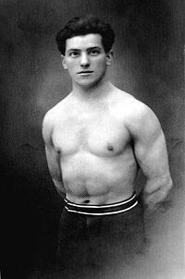
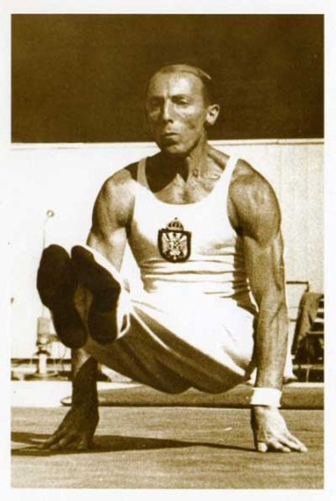
Gymnastics
Bedrich Supcik (CZE) Rope Climbing
Leon Stukelj (YUG) All Around

Slide 21
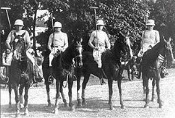
Polo
Argentina Gold Medal

Slide 22
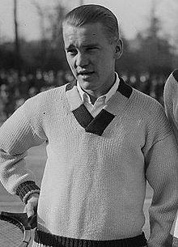
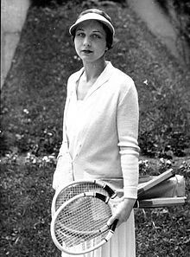
Tennis
Five Gold Medals USA
Vincent Richards Men’s Singles Gold Medal
Helen Wills Moody Women’s Singles Gold

Slide 23
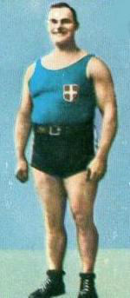
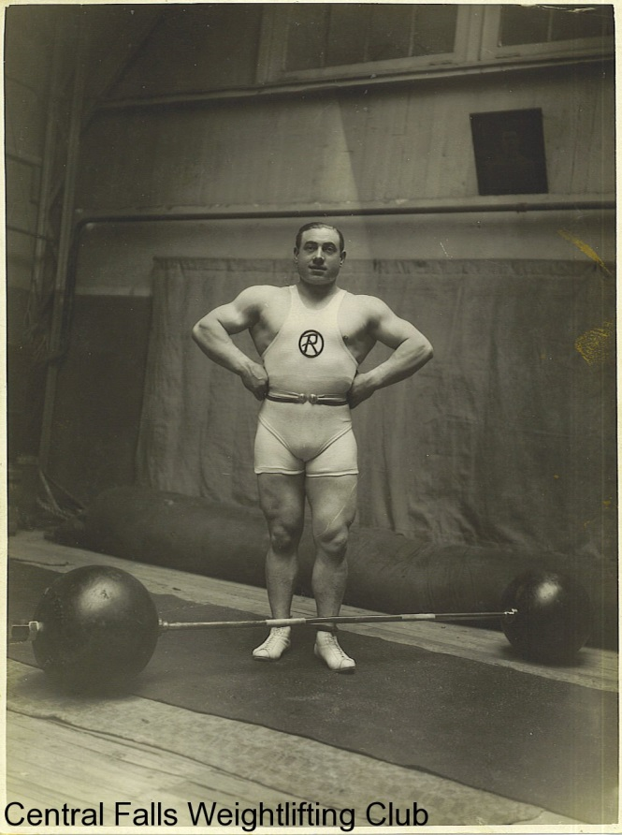
Weightlifting
Guiseppe Tonani Heavy Weight Gold
Charles Rigoulet Light Heavy Weight Gold

Slide 24
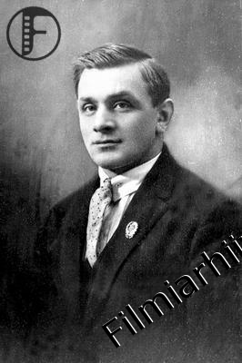
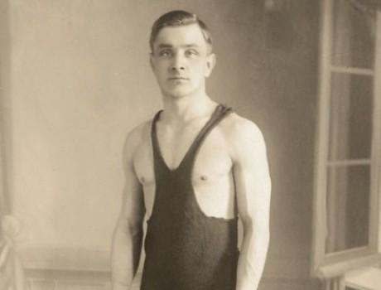
Wrestling Greco-Roman
Eduard Pütsep Bantam Weight Gold Medal

Slide 25
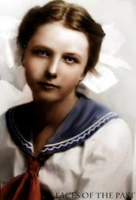
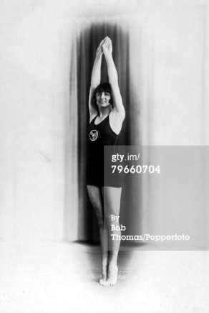
Women’s Diving
Two Events: Americans win five of six medals
Elizabeth Becker and Caroline Smith

Slide 26
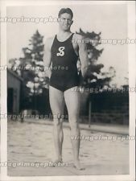
Men’s Diving
Three Events: Albert White of USA wins gold medals in three and ten meter springboard

Slide 27
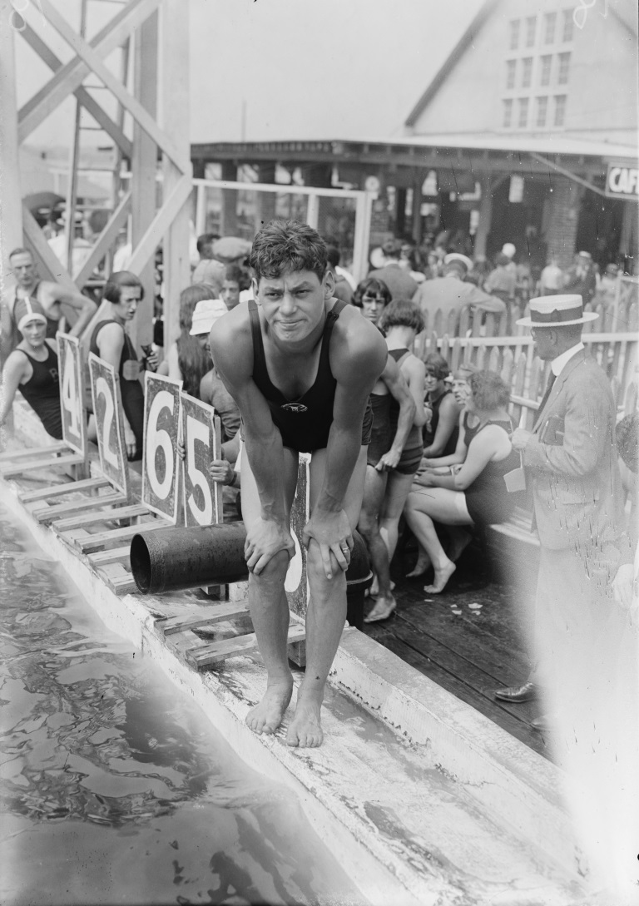
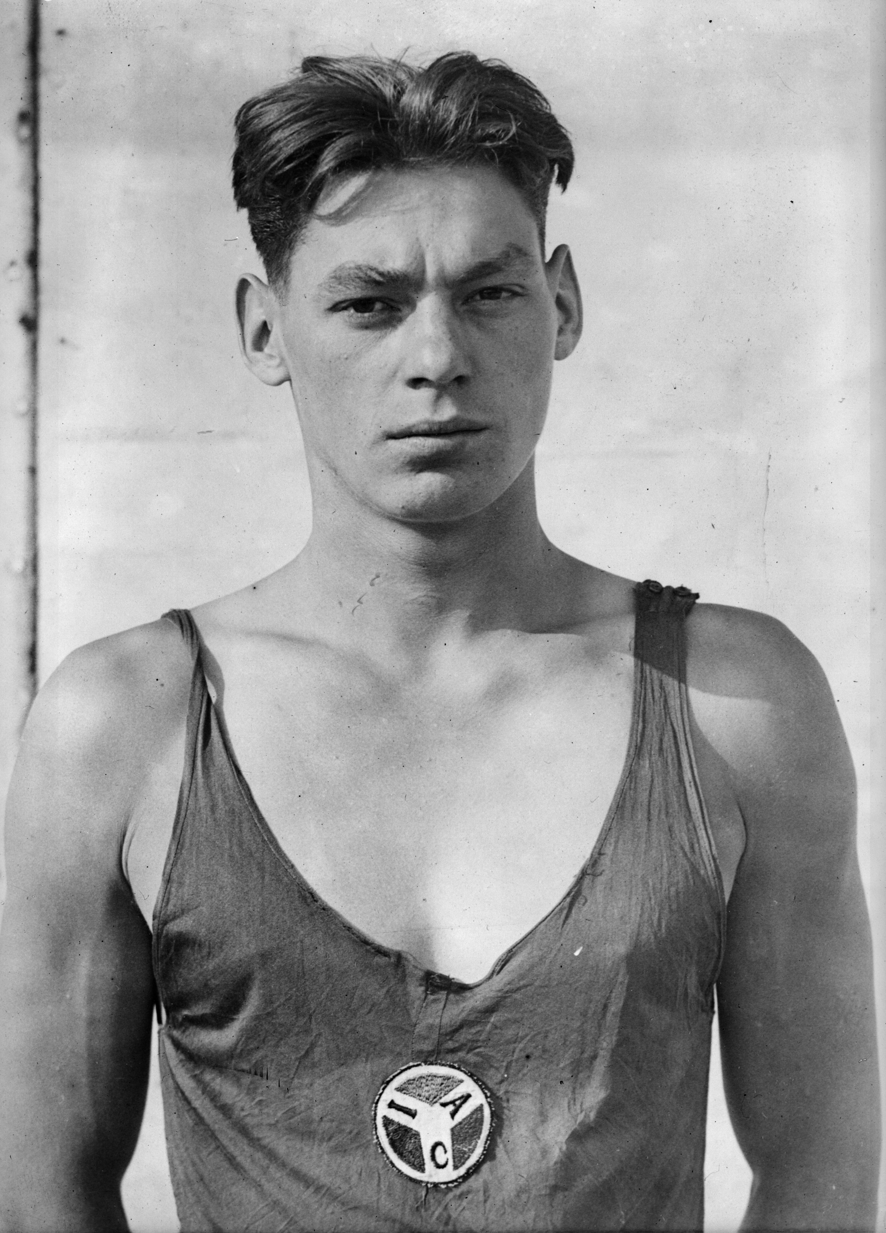
Johnny Weissmuller
Three Gold Medals

Slide 28
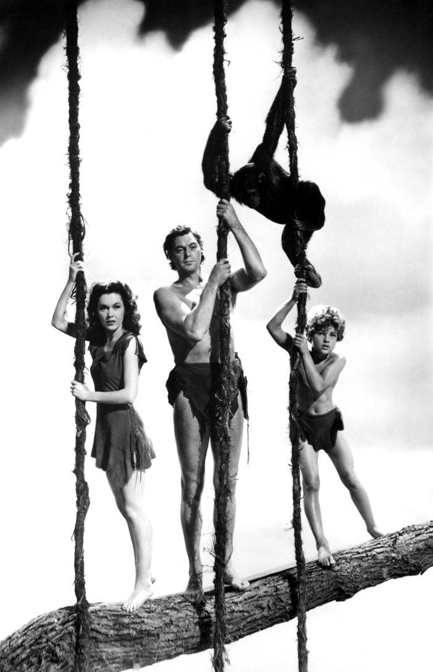
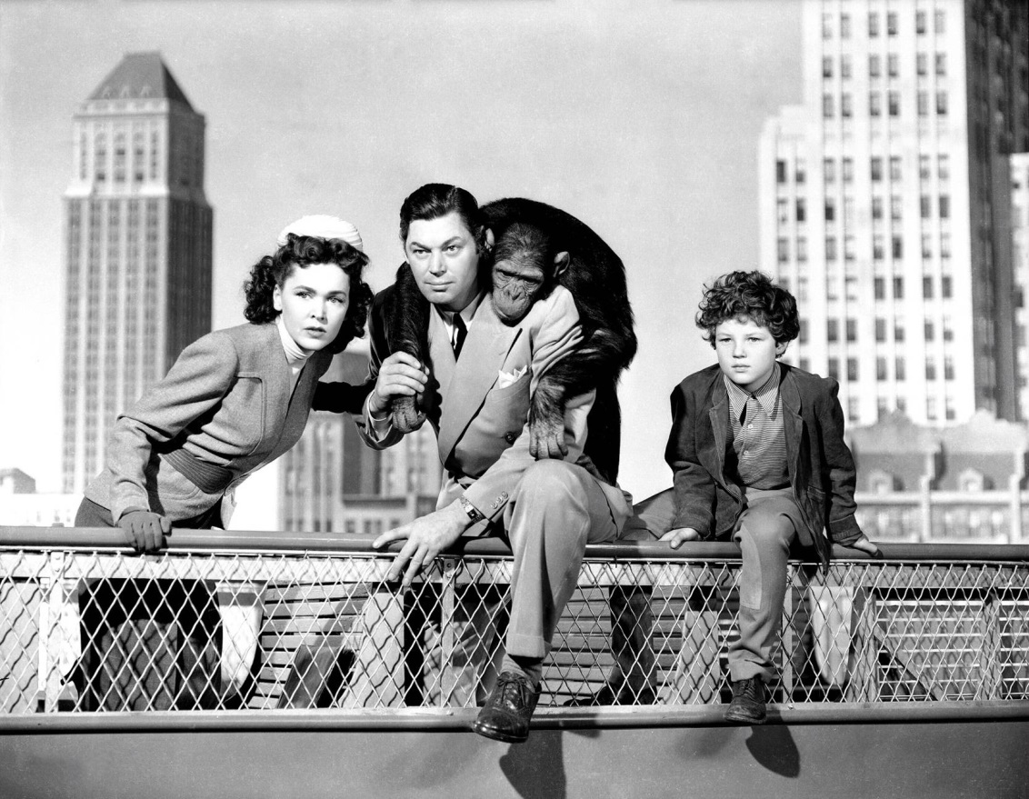
Tarzan

Slide 29
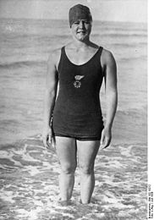
Women’s Swimming
Gertrude Ederle
Gertrude Ederle 1 Gold Medal, 2 Bronze
1926 becomes first woman to swim English Channel

Slide 30
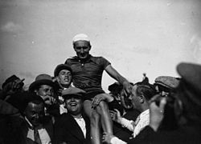
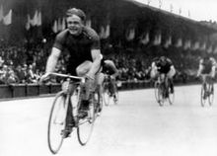
Cycling
Ko Willems 50 KM
Armand Blanchonet

Slide 31
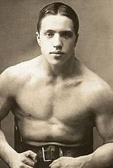
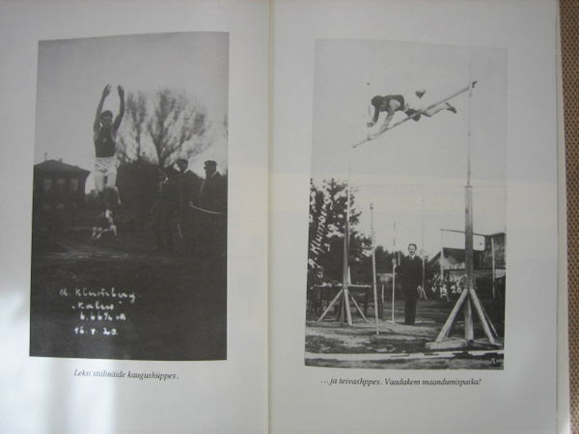
Estonian Athletes
44 male athletes, 6 medals, 1 gold, 1 silver, 4 bronze
Eduard Pütsep (Greco Roman, gold), Alfred Neuland (weightlifitng, silver), Aleksander Klumberg (decathlon, bronze), Jaan Kikkas (weightlifting, bronze), Harald Tammer (weightlifting, bronze), Roman Steinberg (Greco Roman, bronze)

