Slide 1
Researching the Post Baseball Contributions of Jackie Robinson: Resources at the Library of Congress
Alar Lipping, Ph.D.
Northern Kentucky University

Slide 2
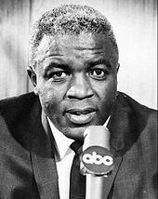
Library of Congress Acquires the Jackie Robinson Papers (2001)
Collection, 1934-2001 (majority 1947-1987)
Collection includes 7,000 items; 17 containers

Slide 4
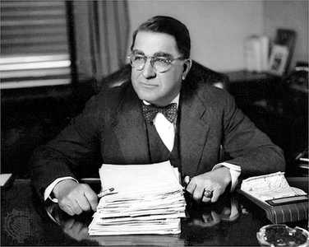
Branch Rickey Papers
Collection, 1890-1969 (majority 1936-1965)
Collection includes 29,400 items, 86 containers

Slide 6
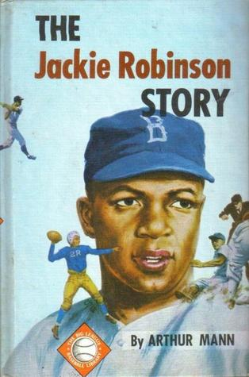
Arthur William Mann Papers
Collection, 1901-1969 (majority 1945-1962)
Collection includes 1,800 items, 13 containers

Slide 7
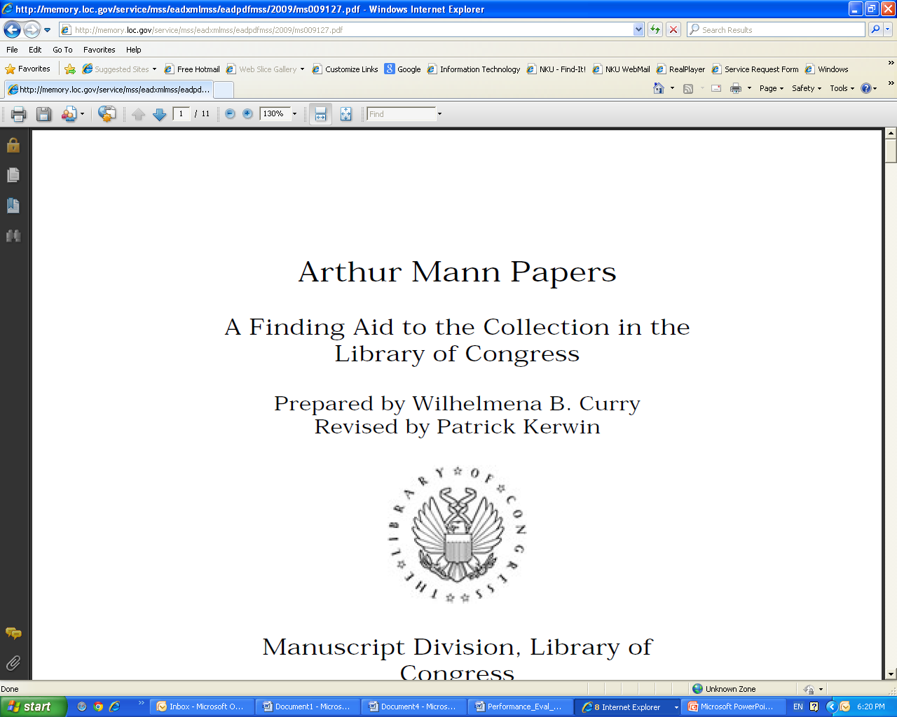

Slide 14
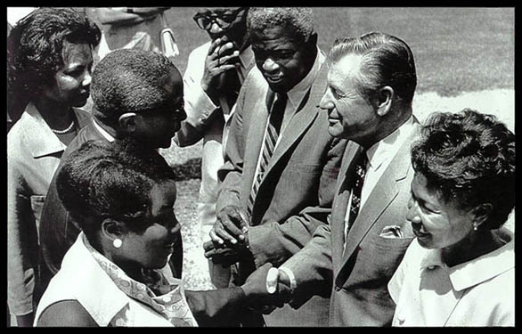

Slide 15
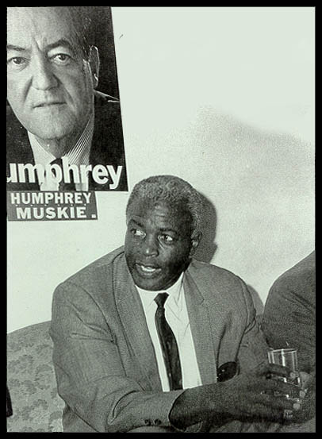

Slide 17
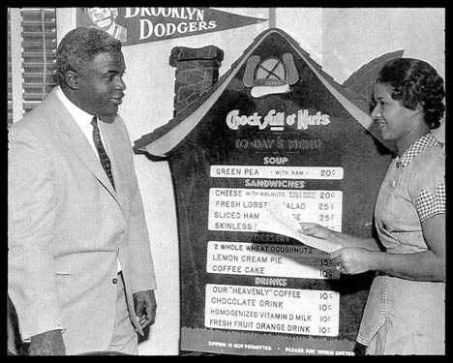
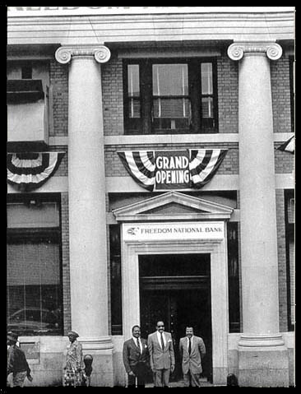

Slide 19
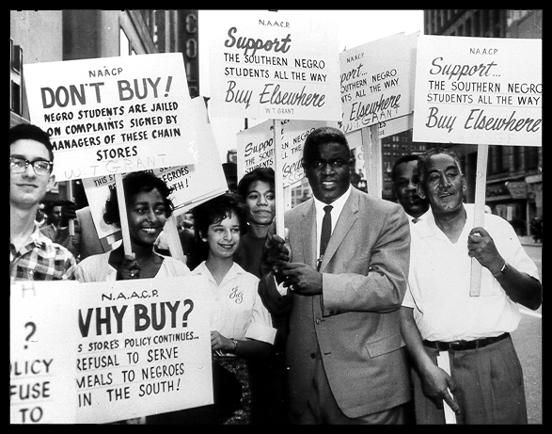

Slide 21
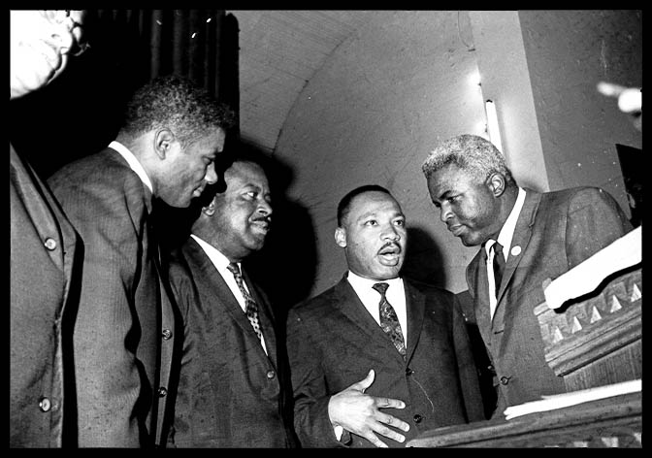

Slide 23
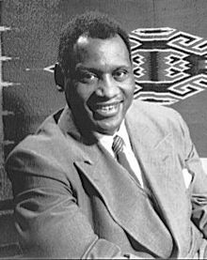
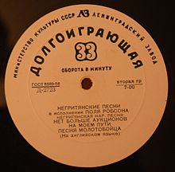

Slide 25
