Slide 1
Understanding the Functional Value of History

Slide 2
Reasons for Studying History
To help in understanding life around us, i.e., why things are the way they are.
For example, the utilization of exercise in cardiac rehab. Where did this practice develop?
Paul Dudley White (June 6, 1886 – October 31, 1973). Paul Dudley White is viewed by most medical authorities as the founder of preventive cardiology. In 1955, the President of the United States had a heart attack. Who was the President? What impact did Dr. White have on the practice of cardiology?

Slide 3
Reasons continued
Through analysis of past events historians can evaluate and provide definitive conclusions pertaining to the conduct of our social institutions. For example, what has been the effect of Title IX on educational opportunities for females?

Slide 4
Reasons continued
To eliminate myths that have perpetuated, e.g., Abner Doubleday myth. Who invented baseball?

Slide 5
Reasons continued
To promote critical thinking. What are the values associated with interscholastic football? How are these values reflections of the broader context of society? Consider football high (the video on concussions in high school football): In 1955 an intercollegiate sport was eliminated when a University of Wisconsin athlete died: what was the sport? Why does high school football continue, in light of the deaths attributed to football?

Slide 6
Reasons continued
To develop interest and appreciation. For example, every community can boast of some historical significance.

Slide 7
Two General Categories Pertaining to the Study of History
Descriptive: deals with historical narration of past events. Deals with who, when, what: basic facts. For Example, Thomas Jefferson in 1776 wrote the Declaration of Independence.
Interpretive: this category takes into account the important question of “why” an event occurred and what significance did a particular event serve. In the aforementioned example, it is more important to know the document’s purpose.

Slide 8
Biography and Social Forces
Biographical Approach: study of contributions of significant individuals.
Social Forces: study dealing with collective movements. Examples would include the influence of technology, immigration, religion, women’s movement, world wars, urbanization, industrialization.

Slide 9
When did the first intercollegiate athletic event take place?
Is this an example of descriptive or interpretive?
August 6, 1852.

Slide 10
What was the significance of the first intercollegiate athletic event?
Is this an example of a descriptive or interpretive approach?
Business influence: Wilkins president of Montreal Concord Railroad Road Company.

Slide 11
On May 14 and 15, 1874 Harvard contested McGill University in two athletic contests. Identify the sport and demonstrate the significance of these contests on subsequent developments in collegiate sport.
Rutgers vs. Princeton, November 6, 1869

Slide 12
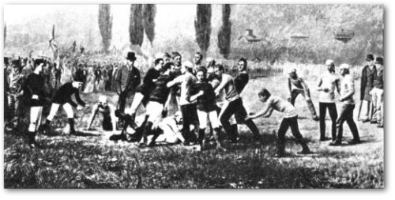
Harvard Versus McGill 1874

Slide 13
On October 9, 1905, President Theodore Roosevelt convened a luncheon meeting at the White House. Who attended this meeting and what was the eventual outcome of this initial meeting?

Slide 14
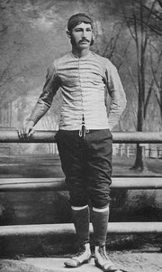
Most Influential Leaders in America During the Late 19th Century
Camp

Slide 15
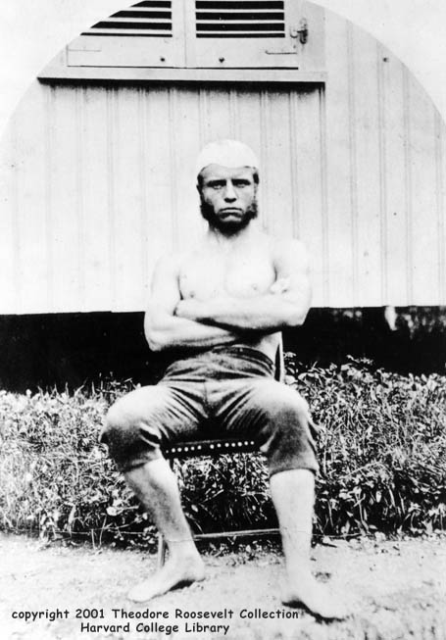
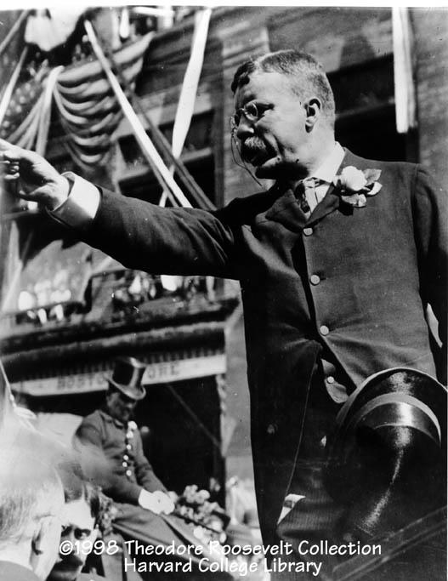
Roosevelt

Slide 16
History Detectives
http://www.pbs.org/opb/historydetectives/investigation/exercise-records/
http://www.starkcenter.org/

Slide 17
http://www.starkcenter.org/research/hack/#/36/
http://www.pbs.org/opb/historydetectives/investigation/exercise-records/

